Slide 1
Assignment 2a
Segmentation
Pick 5 images from Berkeley Segmentation dataset
Run Kmeans and Meanshift
Show results along with the ground-truth

Slide 2
Assignment 2b
Play with Panorama
Use this code
http://ramsrigoutham.com/tag/ransac/
and stitch together a panaroma
Explain how SURF is different from SIFT (10 sentences)
Briefly explain the main principles of FLANN matching (5 sentences)

Slide 3
Assignment 2c
Implement Bike vs Horse Classification
Dataset is available on LMS
Use Bag-of-visual words approach (SIFT/SURF + K-means + Logistic Regression/KNN)
Explain the procedure and your approach and observations

Slide 4
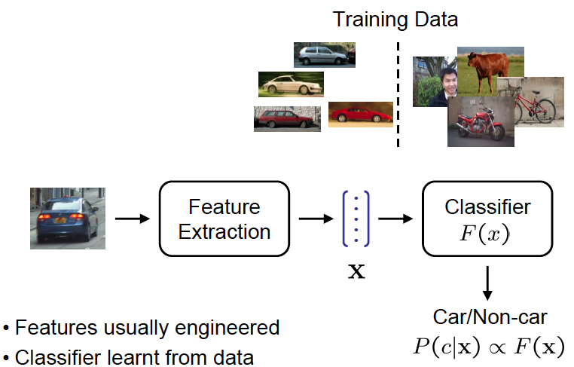
Object Recognition - summary

Slide 5
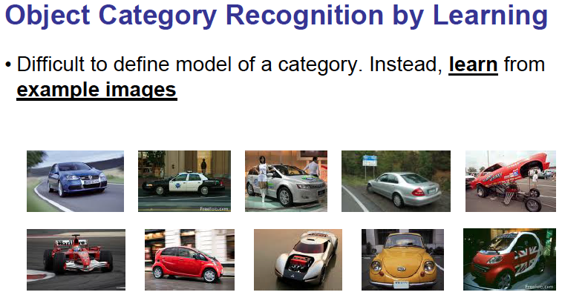
Extract interest points and descriptors for every image
Cluster centers
K- Means Clustering

Slide 6
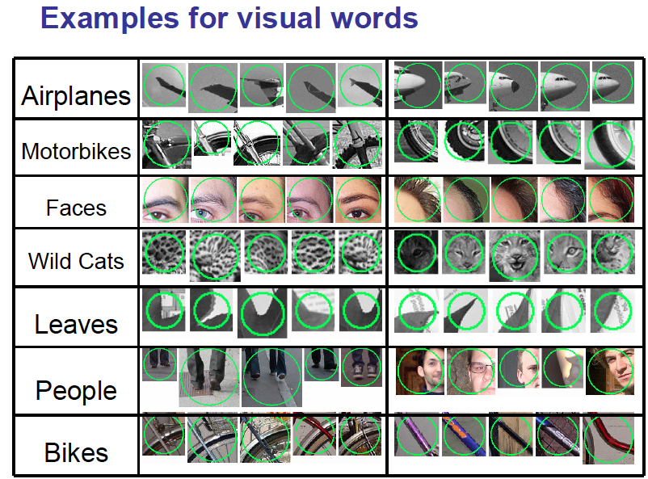
Face recognition

Slide 7
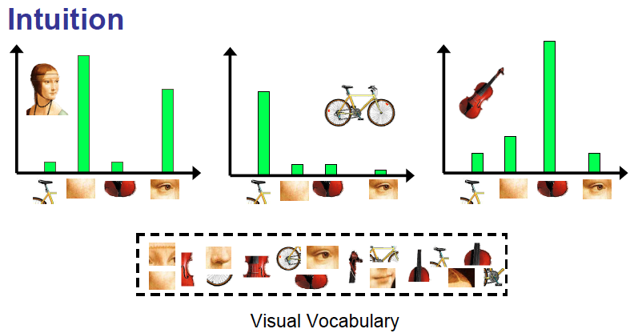
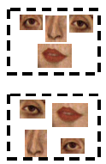
Object recognition

Slide 8
Machine Perception
Hierarchy of concepts
Application/System (Surveillance)
MP Module (e.g Face Recognition)
ML task (e.g Multiclass Classification)
Features, Models (e.g Logistic Regression)
Optimization algorithm (e.g gradient descent)

